Slide 1

Unit 1
Puppet Basics

Slide 2
Overview
What is Puppet?
Why Puppet?
Puppet Architecture
Coding Basics of Puppet

Slide 3
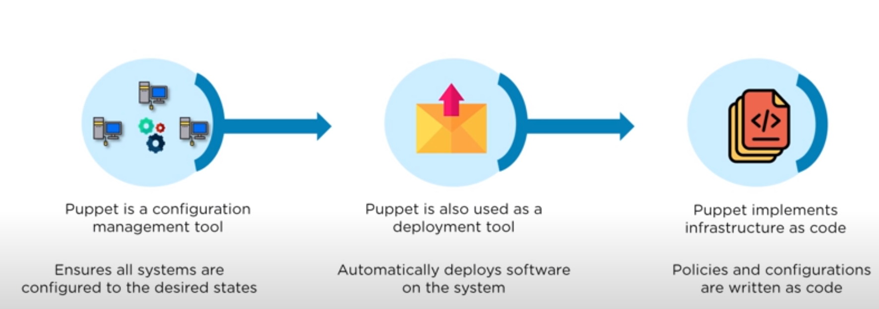
What is Puppet?

Slide 4
What is Puppet?
Puppet is an open-source software configuration management tool.
It runs on many Unix-like systems as well as on Microsoft Windows, and includes its own declarative language to describe system configuration.

Slide 5
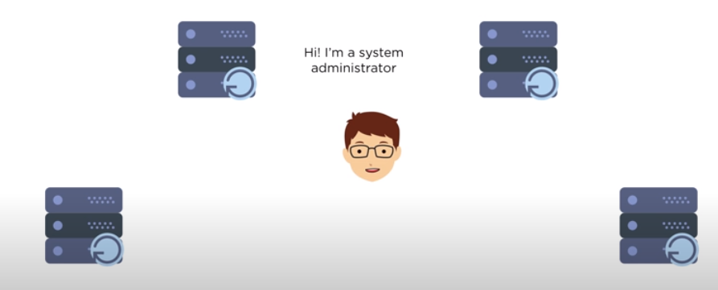
Why Puppet?

Slide 6
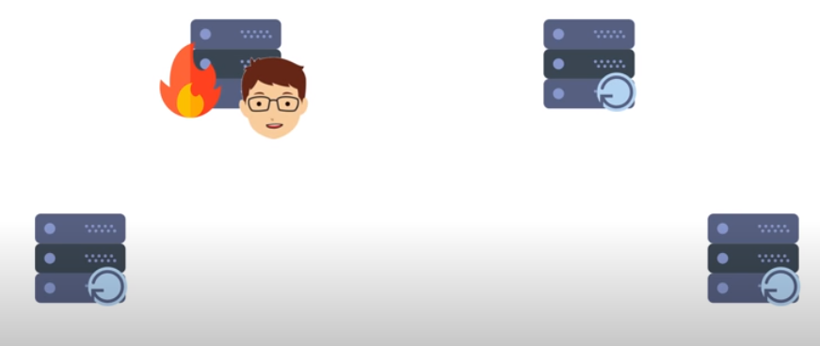
Why Puppet?

Slide 7
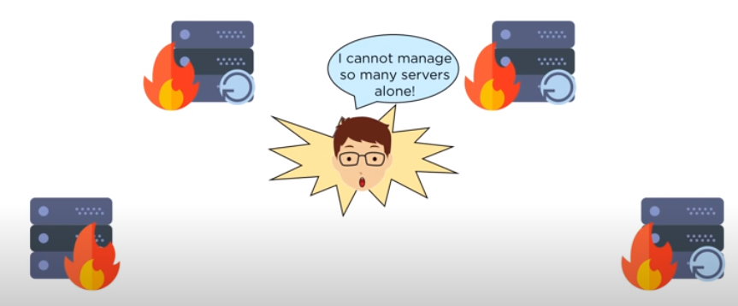
Why Puppet?

Slide 8
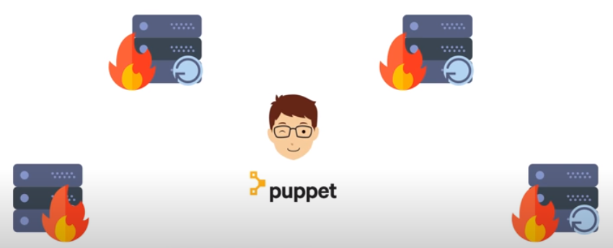
Why Puppet?

Slide 9
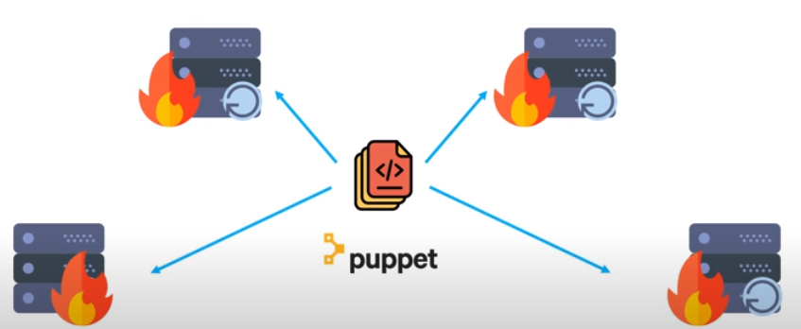
Why Puppet?

Slide 10
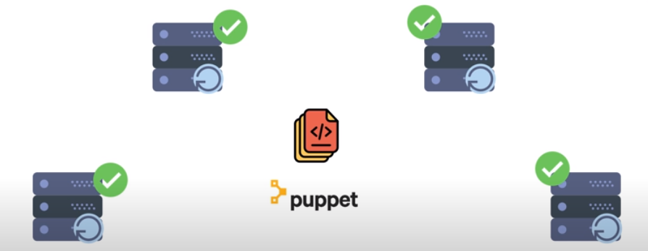
Why Puppet?

Slide 11
Key Features of Puppet
Large User Base
Big Open Source Community
Documentation
Platform Support

Slide 12
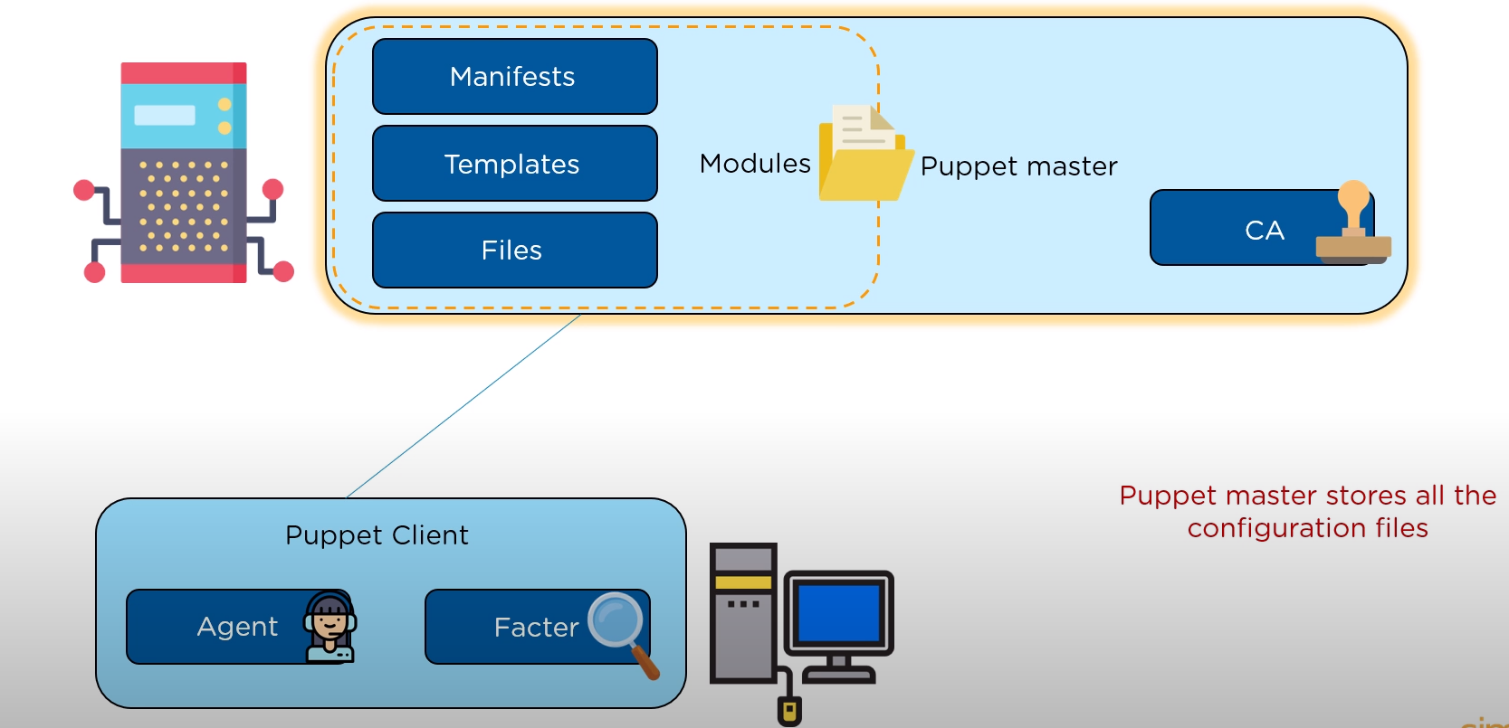
Key Features of Puppet
Notes:
Puppet master stores all the configuration files.
Manifests are the actual codes for configuring the client
Templates combines the code and data to render final document.
Files are the static content that can be downloaded by the client.
Module is a collection of Manifests, Templates and files.
Certificate authority allows the master to sign the certificates sent by the client.
Puppet client is the machine that requires to be configured.
The agent constantly interact with the master and send the certificate.
The factor collects the current state of the client.

Slide 13
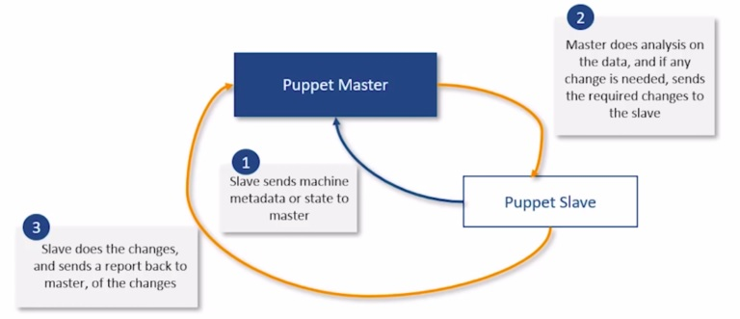
Puppet Architecture

Slide 14
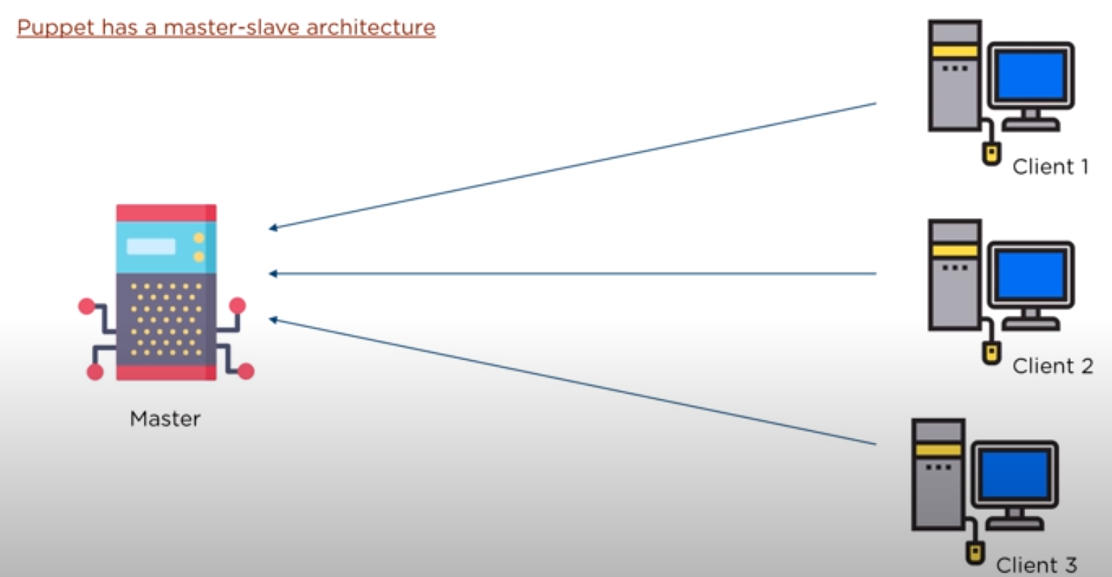
Working with Puppet

Slide 15
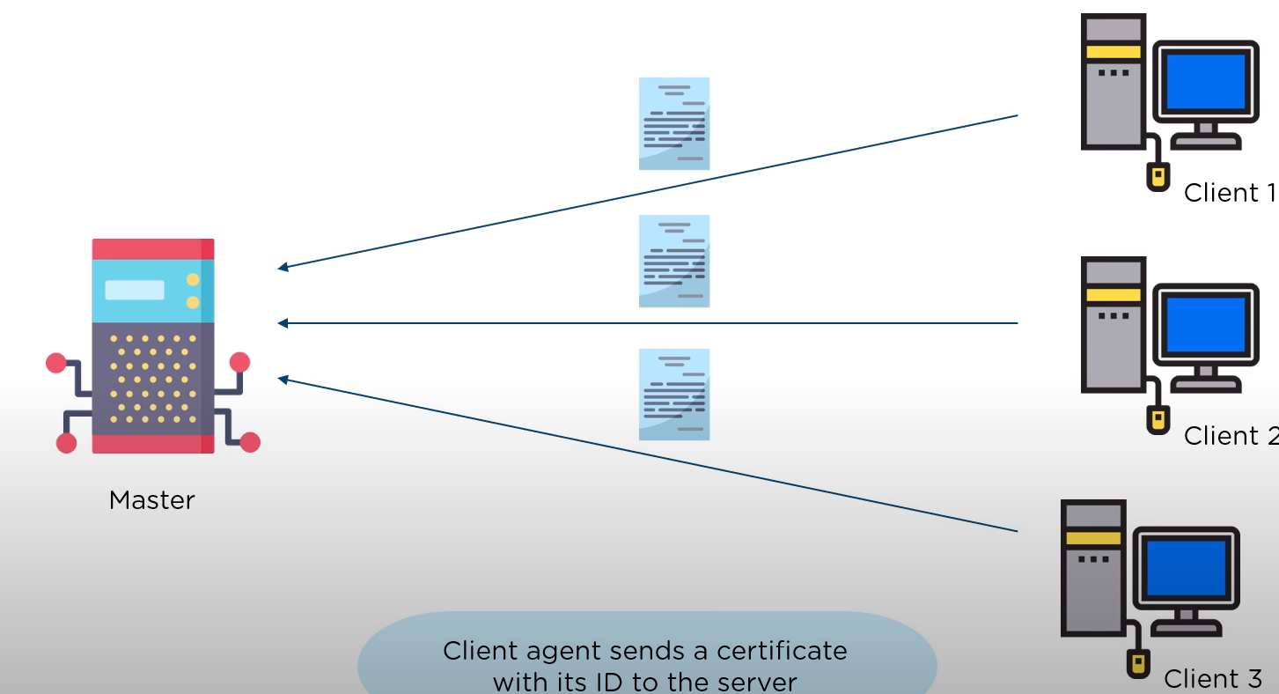
Working with Puppet

Slide 16
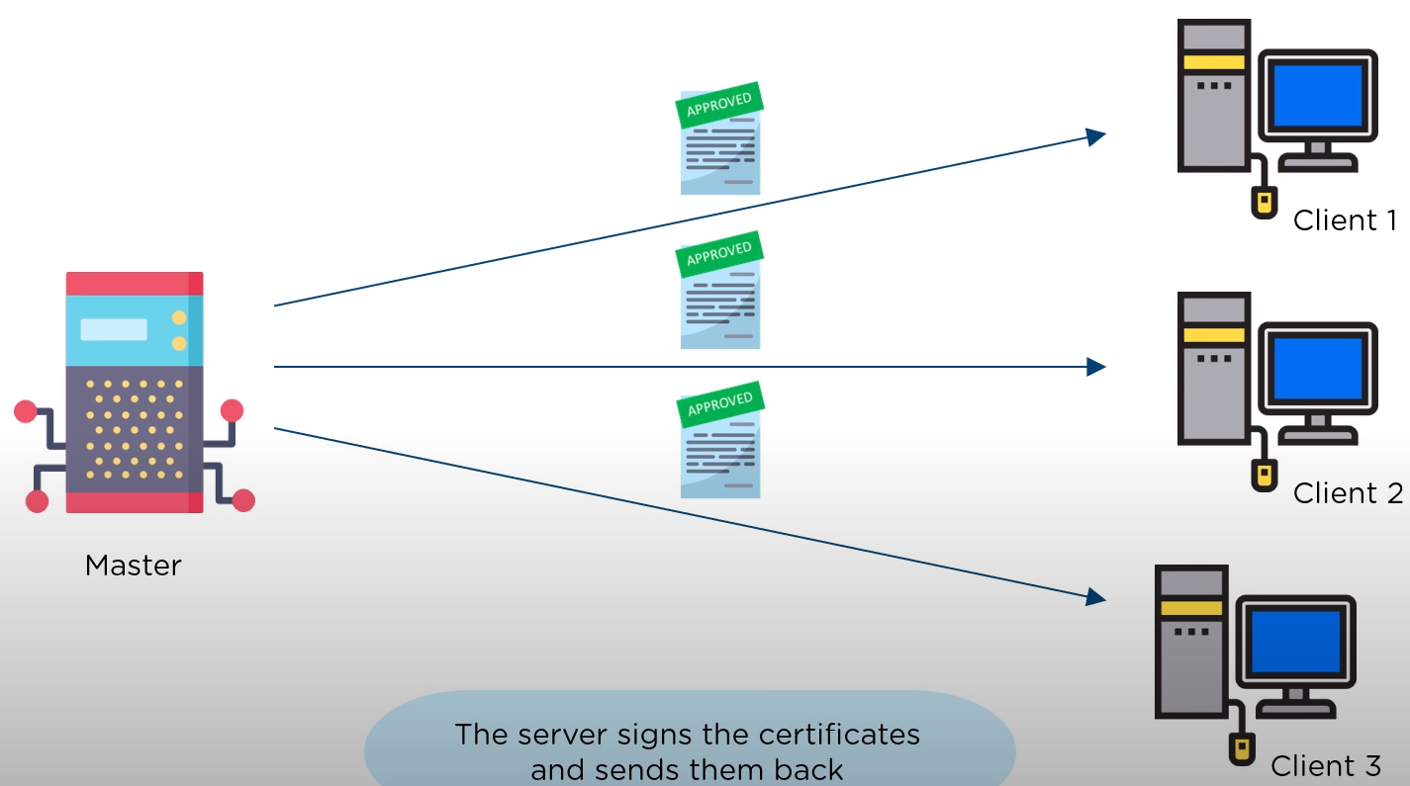
Working with Puppet

Slide 17
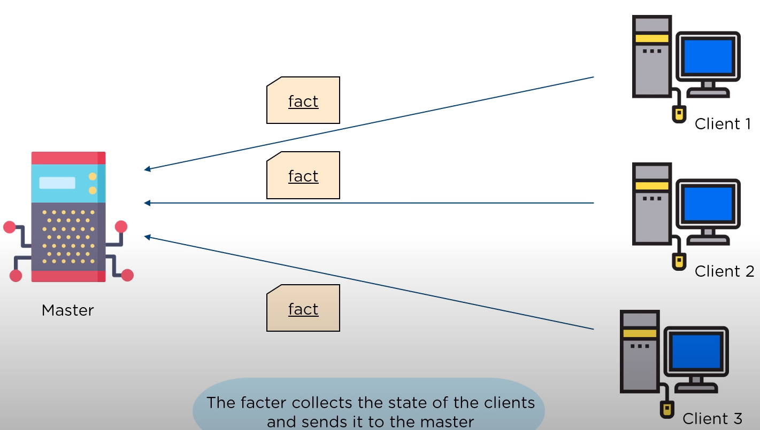
Working with Puppet

Slide 18
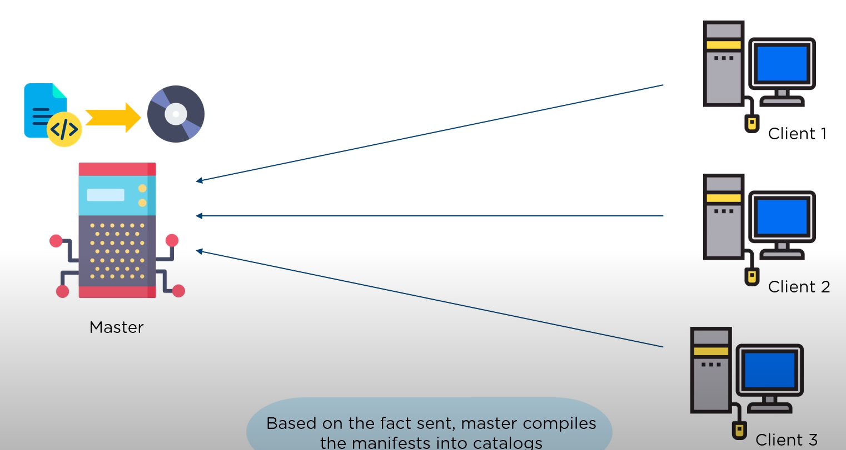
Working with Puppet

Slide 19
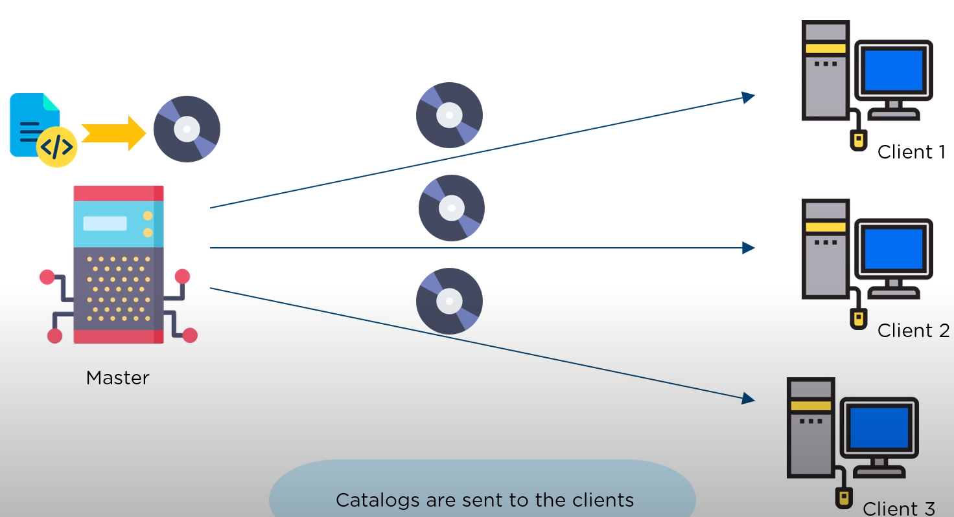
Working with Puppet

Slide 20
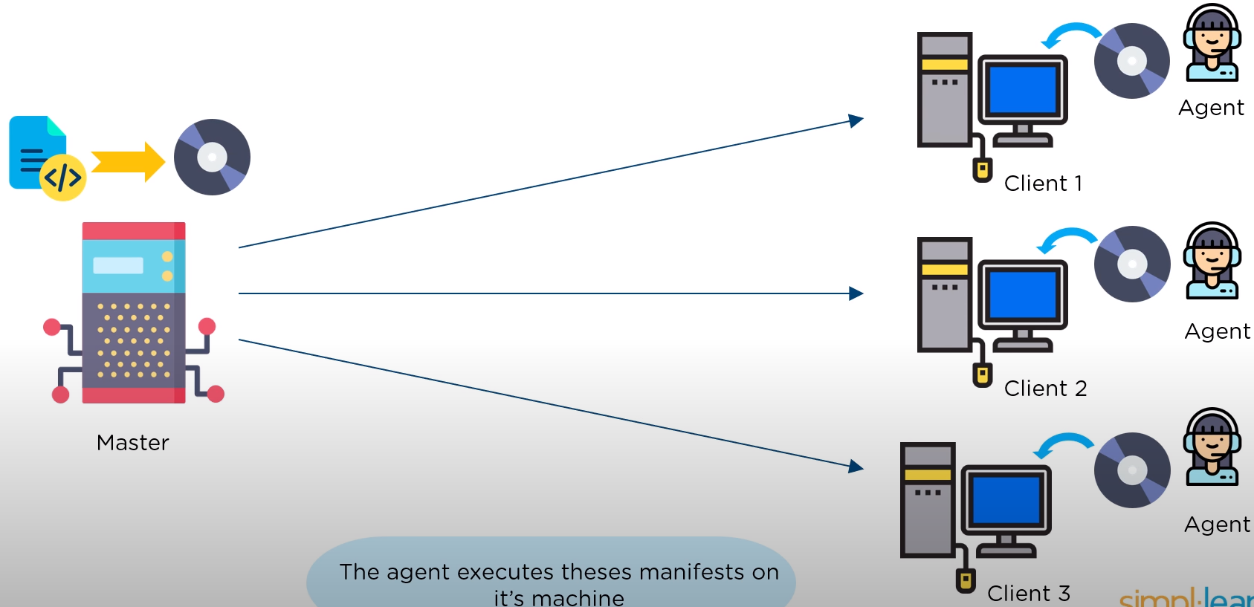
Working with Puppet

Slide 21
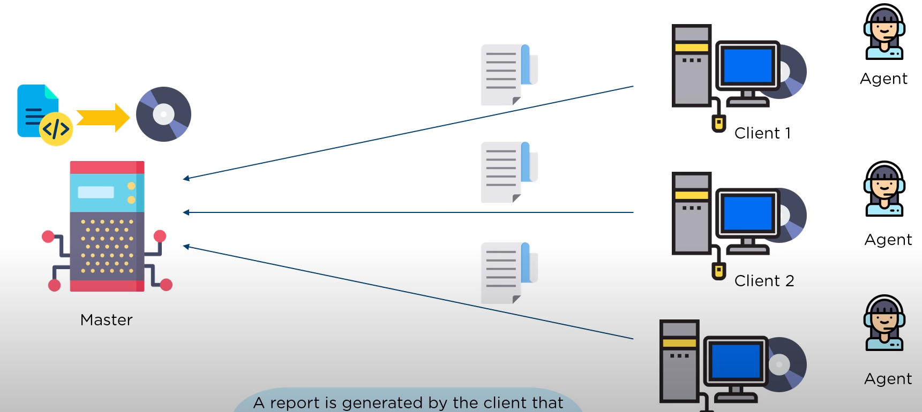
Working with Puppet

Slide 22
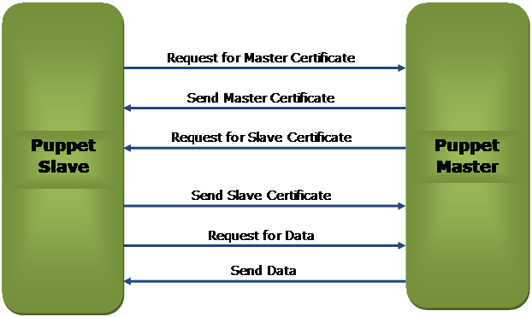
Puppet follows a master-slave pull-based architecture

Slide 23
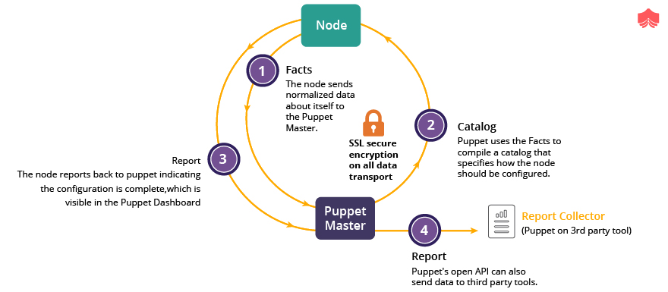

Slide 24
Configuration Management: Use case
New York Stock Exchange (NYSE): A software “glitch” prevented the NYSE from trading stocks for almost 90 minutes. This led to millions of dollars of loss. A new software installation caused the problem. That software was installed on 8 of its 20 trading terminals and the system was tested out the night before. However, it failed to operate properly on the 8 terminals in the morning. So there was a need to switch back to the old software.
You might think that this was a failure of NYSE’s Configuration Management process, but in reality, it was a success. As a result of a proper Configuration Management process, NYSE recovered from that situation in 90 minutes which was pretty fast. Had the problem continued longer, the consequences would have been more severe.

Slide 25
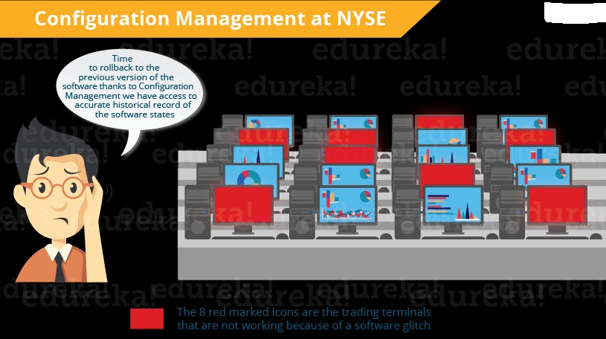

Slide 26
Configuration Management stage can be considered as the backbone of DevOps.
It allows more frequent software releases in the safest and most reliable way possible.

Slide 27

Notes:
https://www.youtube.com/watch?v=QFcqvBk1gNA

Slide 28
POLLING QUESTIONS
What is SSL?
Secure Sockets Layer
Security Sockets Layer
Secure Secure Layer
None of these
Notes:
a

